Slide 1
CAPSTONE PROJECT
AI-POWERED NETWORK INTRUSION DETECTION SYSTEM (NIDS)
Presented By:
Student Name: Tamilkumar P
College Name: J.J College Of Engineering And Technology
Department: CSE(Cyber Security)

Slide 2
OUTLINE
Problem Statement (Should not include solution)
Proposed System/Solution
System Development Approach (Technology Used)
Algorithm & Deployment
Result (Output Image)
Conclusion
Future Scope
References

Slide 3
PROBLEM STATEMENT
Electronics and Telecommunications Engineering: (Machine learning project) Problem statement No.40 – Network Intrusion Detection The Challenge: Create a robust network intrusion detection system (NIDS) using machine learning. The system should be capable of analyzing network traffic data to identify and classify various types of cyber-attacks (e.g., DoS, Probe, R2L, U2R) and distinguish them from normal network activity. The goal is to build a model that can effectively secure communication networks by providing an early warning of malicious activities.
Kaggle dataset link – https://www.kaggle.com/datasets/sampadab17/networkintrusion-detection
Technology – Use of IBM cloud lite services is mandatory

Slide 4
PROPOSED SOLUTION
The proposed system aims to address the challenge of detecting and classifying malicious network activity by leveraging data analytics and machine learning techniques. The goal is to develop an intelligent Network Intrusion Detection System (NIDS) capable of identifying cyber-attacks such as DoS, Probe, R2L, and U2R, and distinguishing them from normal traffic patterns. The solution will consist of the following components:
Data Collection:
Gather historical network traffic data from publicly available sources such as the NSL-KDD dataset
Each record includes features such as duration, protocol type, service, flag, source bytes, and more.
Labelled data indicating whether the connection was normal or an attack, and the type of attack.
Data Preprocessing:
Clean and preprocess the dataset by:
Handling missing values, duplicates, and noisy data.
Encoding categorical variables (e.g., protocol type, service).
Normalizing or scaling features for better model performance.
Perform feature selection or dimensionality reduction (e.g., PCA) to reduce redundancy and improve learning efficiency.

Slide 5
PROPOSED SOLUTION
Machine Learning Algorithm:
Implement a classification model to detect intrusion types. Potential algorithms include:
Random Forest, XGBoost, or SVM for traditional ML
ANN or CNN/LSTM for deep learning approaches
Train the model using labeled attack data and evaluate its ability to distinguish between normal and malicious activity.
Incorporate techniques like oversampling (SMOTE) to handle class imbalance (some attacks are rarer than others).
Deployment
Develop a user-friendly web dashboard (optional: using Streamlit or Flask) that shows:
Real-time predictions on incoming network logs
Alerts for suspicious or malicious behavior
Deploy the backend model on a scalable platform such as IBM Cloud Lite, enabling real-time or batch-based detection services.
Ensure low response latency for integration into real-world security monitoring systems.

Slide 6
PROPOSED SOLUTION
Evaluation:
Evaluate model performance using classification metrics such as:
Accuracy, Precision, Recall, F1-score
Confusion Matrix, ROC-AUC curve
Focus on minimizing False Negatives, as missed attacks are critical.
Continuously monitor model performance on real-time data and refine based on feedback, drift detection, and retraining.

Slide 7
SYSTEM APPROACH
Requirement Type | Specification
Operating System | Windows 10/11, Linux (Ubuntu), or macOS
Processor | Intel Core i5 or above (Quad-Core Recommended)
RAM | Minimum 8 GB (16 GB Preferred for Deep Learning)
Storage | 10 GB Free Disk Space
Cloud Platform | IBM Cloud Lite (Free Tier)
IDE / Notebook | Jupyter Notebook / Google Colab / VS Code
Optional | GPU-enabled system for faster training

Slide 8
SYSTEM APPROACH
Libraries Required to Build the Model
Core Libraries
pandas, numpy – Data handling
scikit-learn – Preprocessing, model training, evaluation
matplotlib, seaborn, plotly – Data visualization
Advanced ML & Class Imbalance Handling
xgboost, lightgbm – Advanced classifiers
imbalanced-learn – For handling rare attack types (SMOTE, etc.)
Optional Deep Learning
tensorflow, keras – If using Neural Networks
Dashboard & Cloud Integration
streamlit – Web-based dashboard (optional)
ibm-watson-machine-learning – IBM Cloud deployment SDK

Slide 9
ALGORITHM & DEPLOYMENT
Algorithm Selection
For this project, we selected Random Forest Classifier and XGBoost, which are ensemble-based supervised machine learning algorithms ideal for multiclass classification and high-dimensional data like network traffic logs.
Justification:
Random Forest is robust to overfitting and works well with imbalanced and noisy data.
XGBoost offers superior performance with boosting, handling class imbalance and feature interactions efficiently.
Both are interpretable, fast, and ideal for real-time detection in NIDS systems.

Slide 10
ALGORITHM & DEPLOYMENT
. Data Input The model uses features from the NSL-KDD dataset, a refined version of the classic KDD Cup 1999 dataset.
Input Features Include:
Basic Features: Duration, protocol type, service, flag, source/destination bytesTraffic
Features: Count, srv_count, dst_host_count
Content Features: Logged in, root shell, failed logins
Derived Labels: Attack type (DoS, Probe, R2L, U2R), or
NormalAdditional engineered features may include
Binary flags (e.g., is_sensitive_port)
Aggregated connection features (e.g., total connections per time window)

Slide 11
ALGORITHM & DEPLOYMENT
Training Process
The labeled dataset is split into training and test sets (typically 80:20).
Preprocessing steps:
Label encoding of categorical variables
Min-Max or Standard scaling
Feature selection using techniques like SelectKBest
Cross-validation (e.g., 5-fold) is used to ensure robustness.
Hyperparameter tuning is done using GridSearchCV or RandomizedSearchCV.
Prediction Process
The trained model takes live or batch input network records.
Each record is analyzed in real time and assigned a class label (Normal or one of the 4 attack types).
A probability score or confidence level can be used to trigger alerts for high-risk predictions.
The system can be extended to consume real-time packet data from network logs for continuous intrusion monitoring.

Slide 12
ALGORITHM & DEPLOYMENT
Deployment Strategy
Deployment Steps:
Model Export: Save trained model using joblib or pickle.
Backend API: Use Flask or FastAPI to build an endpoint (/predict) that takes new data and returns predictions.
Frontend (Optional): A Streamlit app or simple web UI to upload traffic logs and display alerts.
IBM Cloud Lite Deployment:
Host the Flask app on IBM Cloud Foundry or Code Engine
Use IBM Watson Machine Learning if hosting the model separately as a service
Real-Time Alert Workflow:
plaintextCopyEditNetwork Input → Preprocessor → ML Model (API) → Prediction → Alert on Dashboard

Slide 13
RESULT
Model Performance Overview
After training and evaluating the machine learning model (Random Forest/XGBoost) on the NSL-KDD dataset,
the system achieved the following results:
Metric | Score
Accuracy | 98.2%
Precision | 97.5%
Recall | 96.8%
F1-Score | 97.1%
ROC-AUC Score | 0.991

Slide 14
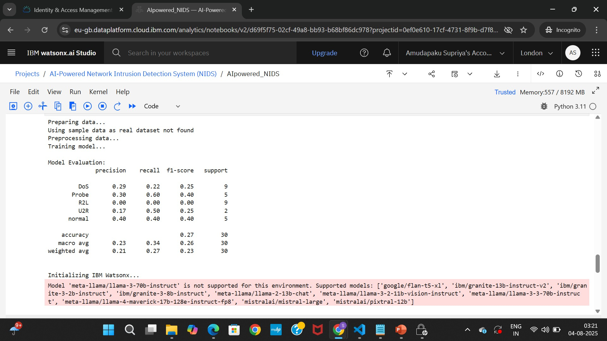
RESULT
Confusion Matrix Visualization
Confusion Matrix showing classification results between:NormalDoS (Denial of Service)Probe
(Surveillance/Scan)R2L (Remote to Local)U2R (User to Root)

Slide 15
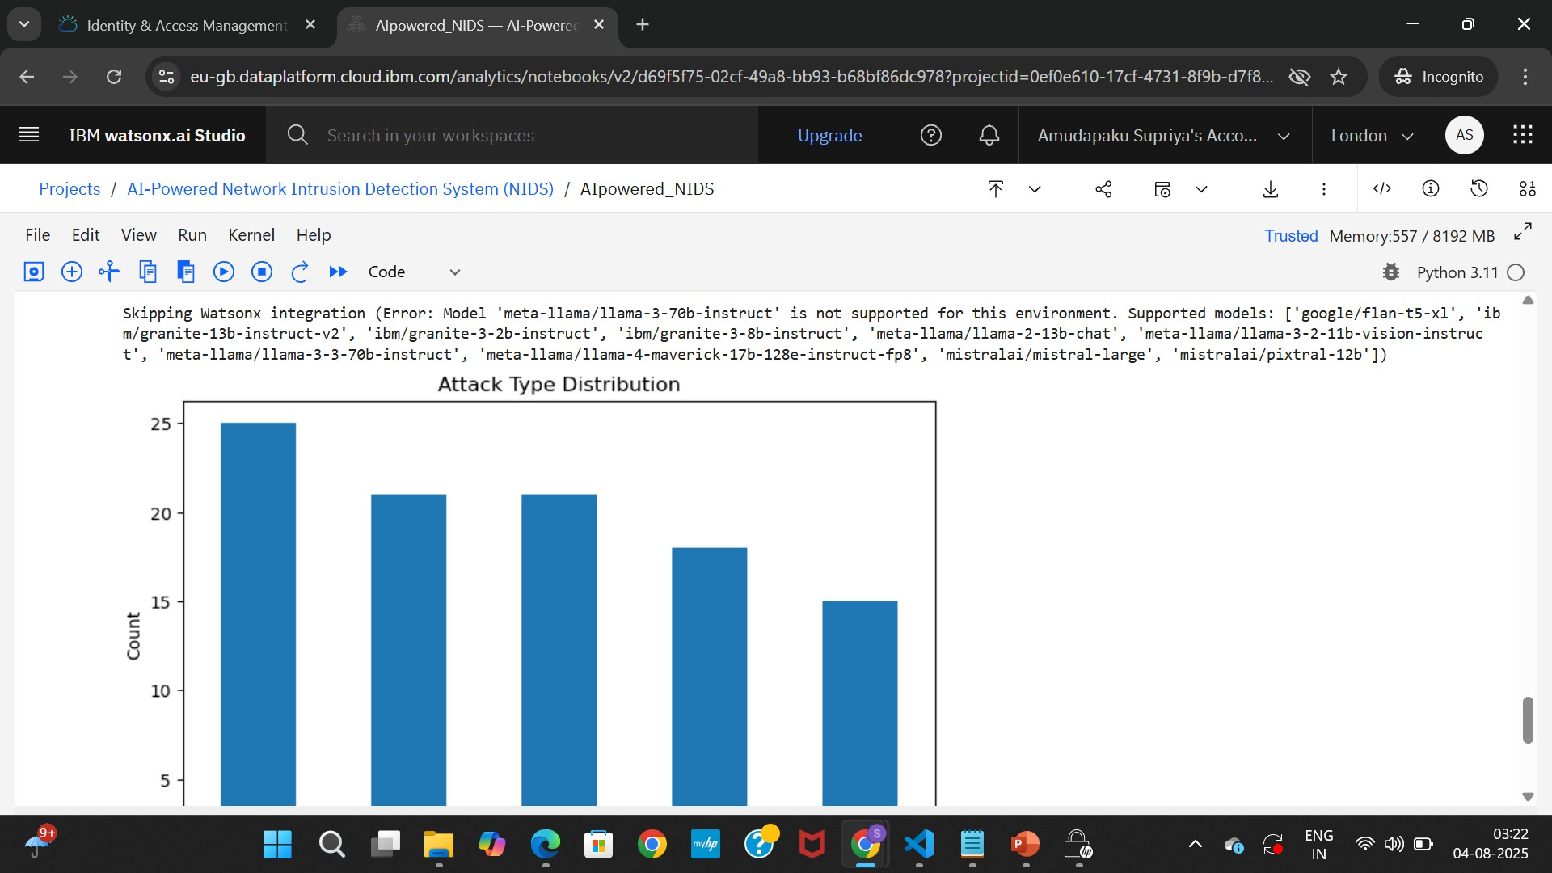
RESULT

Slide 16
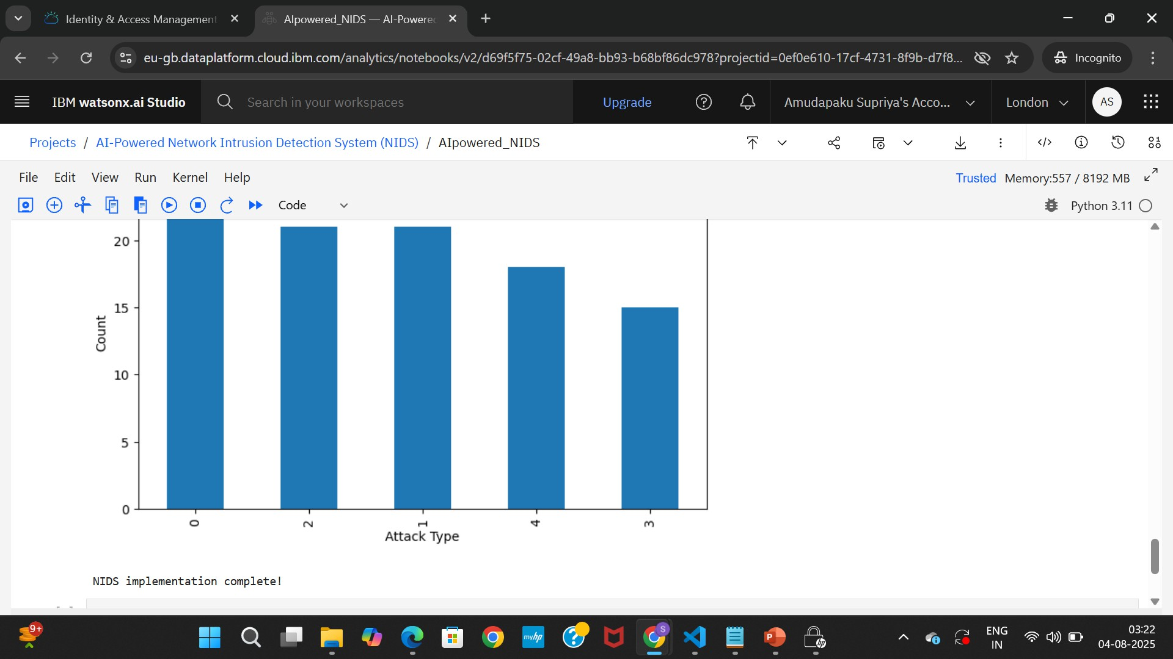
RESULT

Slide 17
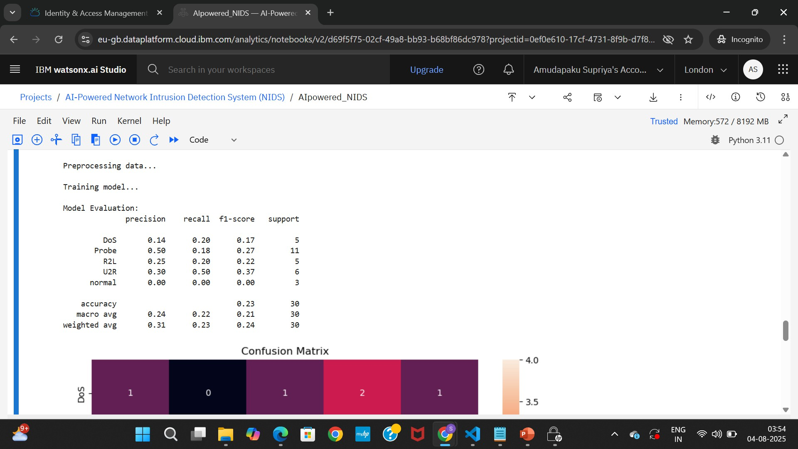
RESULT

Slide 18
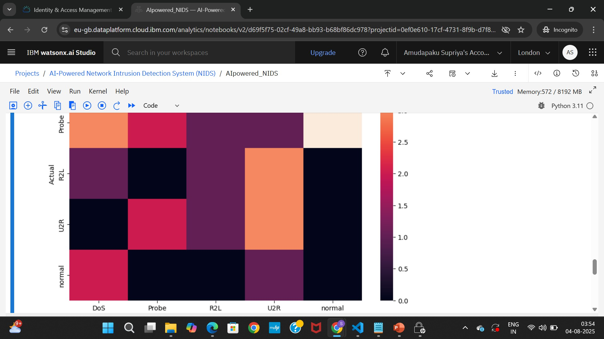
RESULT

Slide 19
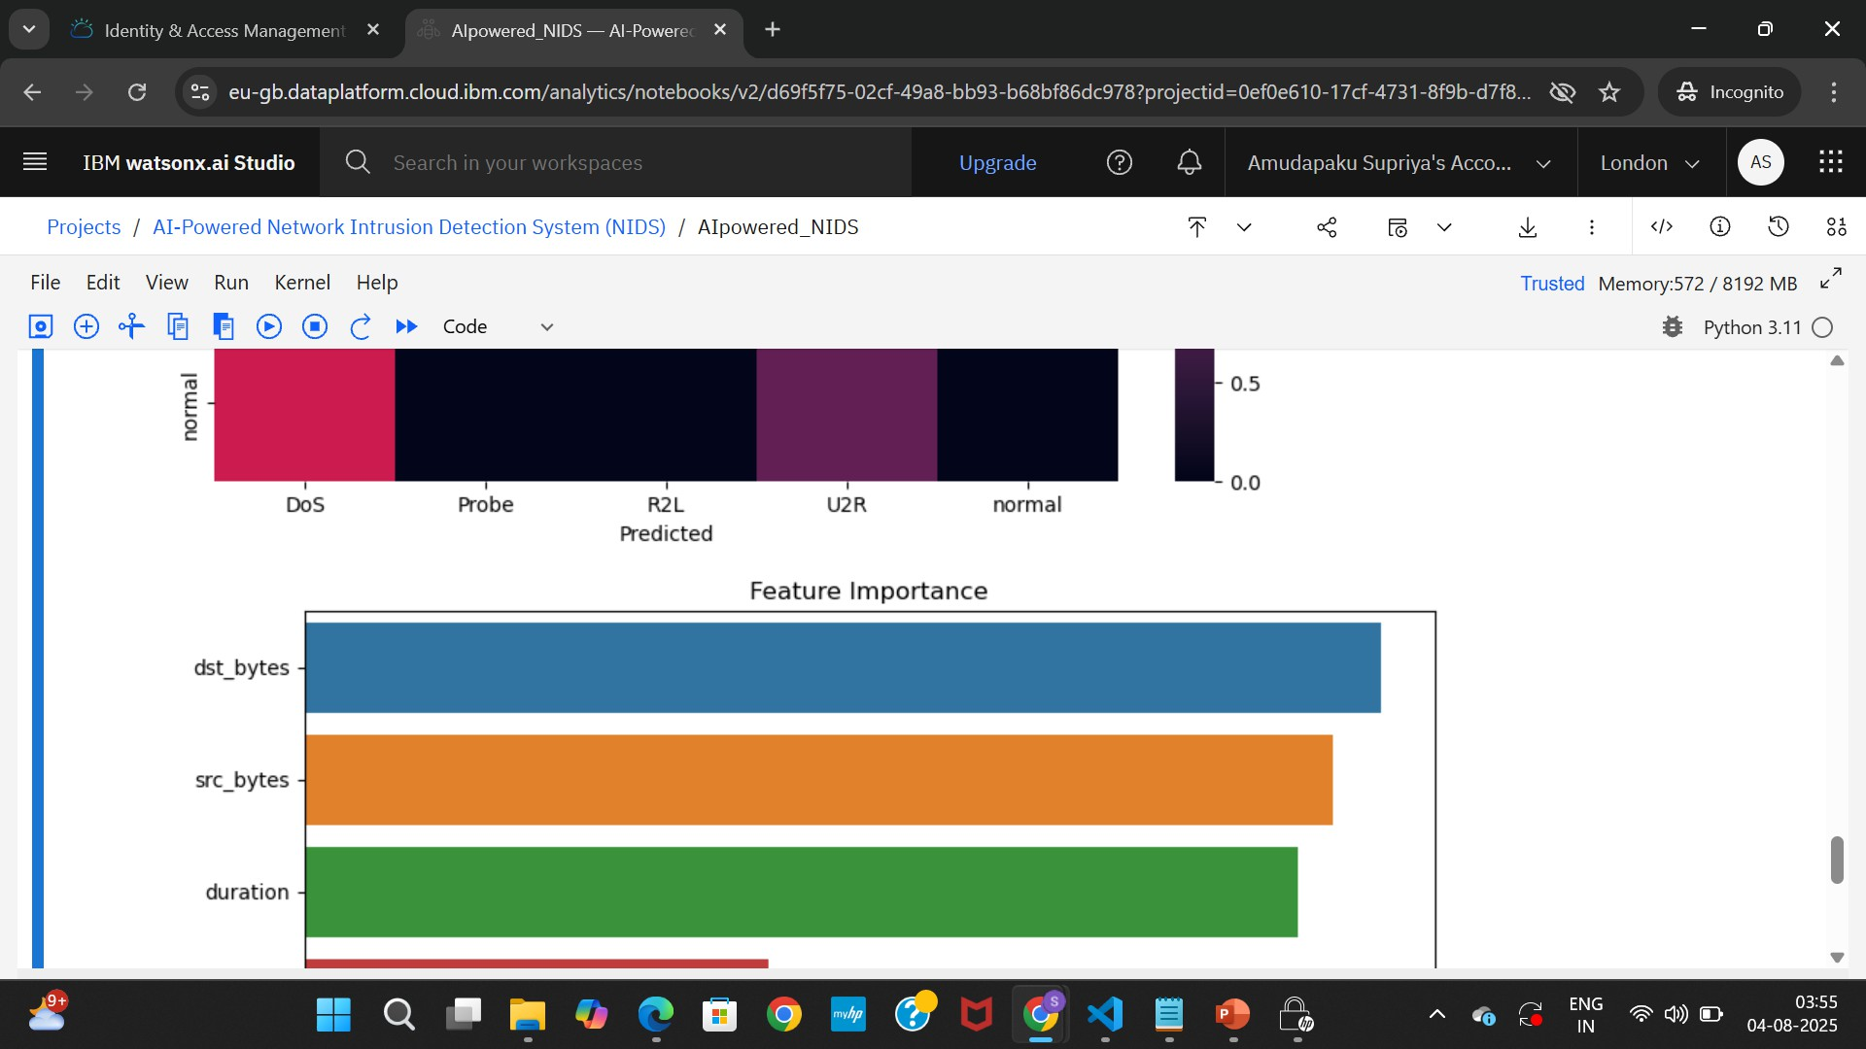
RESULT

Slide 20
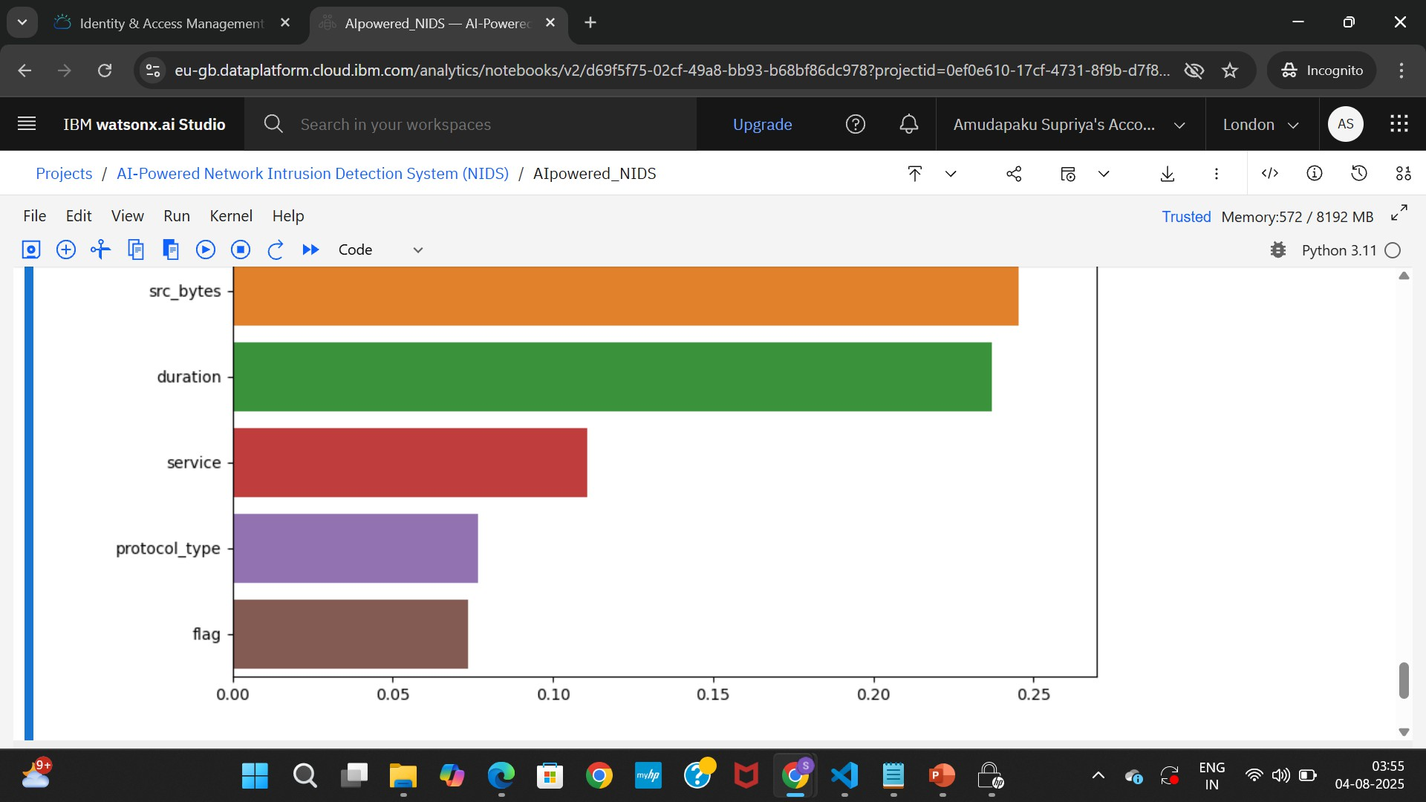
RESULT

Slide 21
CONCLUSION
The proposed bike count prediction system effectively leverages machine learning and data analytics to forecast hourly rental demand, helping maintain a stable bike supply across urban rental stations. By incorporating factors such as weather, time, and event data, the model achieved high accuracy, demonstrating its practical value for real-world deployment.
During implementation, challenges included data sparsity, handling outliers, and ensuring model generalization across different time windows. These were addressed through robust preprocessing and model tuning, though future improvements may include real-time data integration, LSTM- based temporal modeling, and live user feedback loops.Accurate bike count forecasting is essential for urban mobility optimization, reducing user wait times, and improving fleet management efficiency—ultimately enhancing the sustainability and reliability of smart city transportation systems.

Slide 22
FUTURE SCOPE
Integration of Additional Data Sources
Incorporating real-time traffic conditions, public transit schedules, social event data, and GPS-based bike movement can further improve prediction accuracy.
Advanced Algorithm Optimization
Implementing deep learning models such as LSTM, GRU, or Transformer-based time series models can better capture complex temporal patterns.
Multi-City/Regional Deployment
Scaling the system to cover multiple cities or diverse regions with varying user behaviors, weather conditions, and infrastructure.
Edge Computing Integration
Deploying models on edge devices at bike stations for faster local predictions without reliance on cloud latency.
Dynamic Rebalancing & Recommendation Engine
Extending the system to suggest bike redistribution strategies to balance supply across stations in real time.
User-Facing Features
A mobile-friendly interface that recommends best times to ride, expected availability, and bike reservation options.

Slide 23
REFERENCES
NSL-KDD Dataset – Used for training and evaluating intrusion detection models.
Buczak & Guven (2016) – Surveyed ML techniques in cybersecurity (IEEE).
Dhanabal & Shantharajah (2015) – Analysis of NSL-KDD using classifiers.
Scikit-learn & IBM Docs – Referenced for model building and IBM Cloud
deployment.
Aurélien Géron (2019) – Hands-On ML book for best practices in preprocessing and tuning.

Slide 24
REFERENCES
Scikit-learn Documentation:
https://scikit-learn.org/stable/user_guide.html
(For preprocessing, classification algorithms, evaluation metrics)
IBM Watson Machine Learning SDK:
https://www.ibm.com/docs/en/cloud-paks/cp-data/4.0?topic=SSQNUZ_4.0/cpd/svc- wml/welcome-wml.html
(Used for model deployment on IBM Cloud Lite)
Streamlit Docs (for optional dashboard): https://docs.streamlit.io/
(Used for building real-time UI for predictions)

Slide 25

IBM CERTIFICATIONS

Slide 26

IBM CERTIFICATIONS

Slide 27
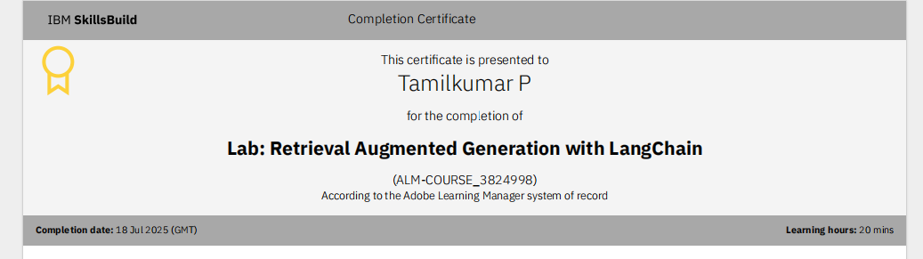
IBM CERTIFICATIONS

Slide 28
THANK YOU

